Slide 1
JOURNEY PPT
Custom IDA
03 Oct 2023 – 04 Oct 2023
- Musaddiq Shariff

Slide 2
Week 7: Day -1 – Azure ML
Introduction to Azure ML
Understanding Dataset
Performing Data preparation and transformation
Introduction to pipelines
Exploring various ML models

Slide 3
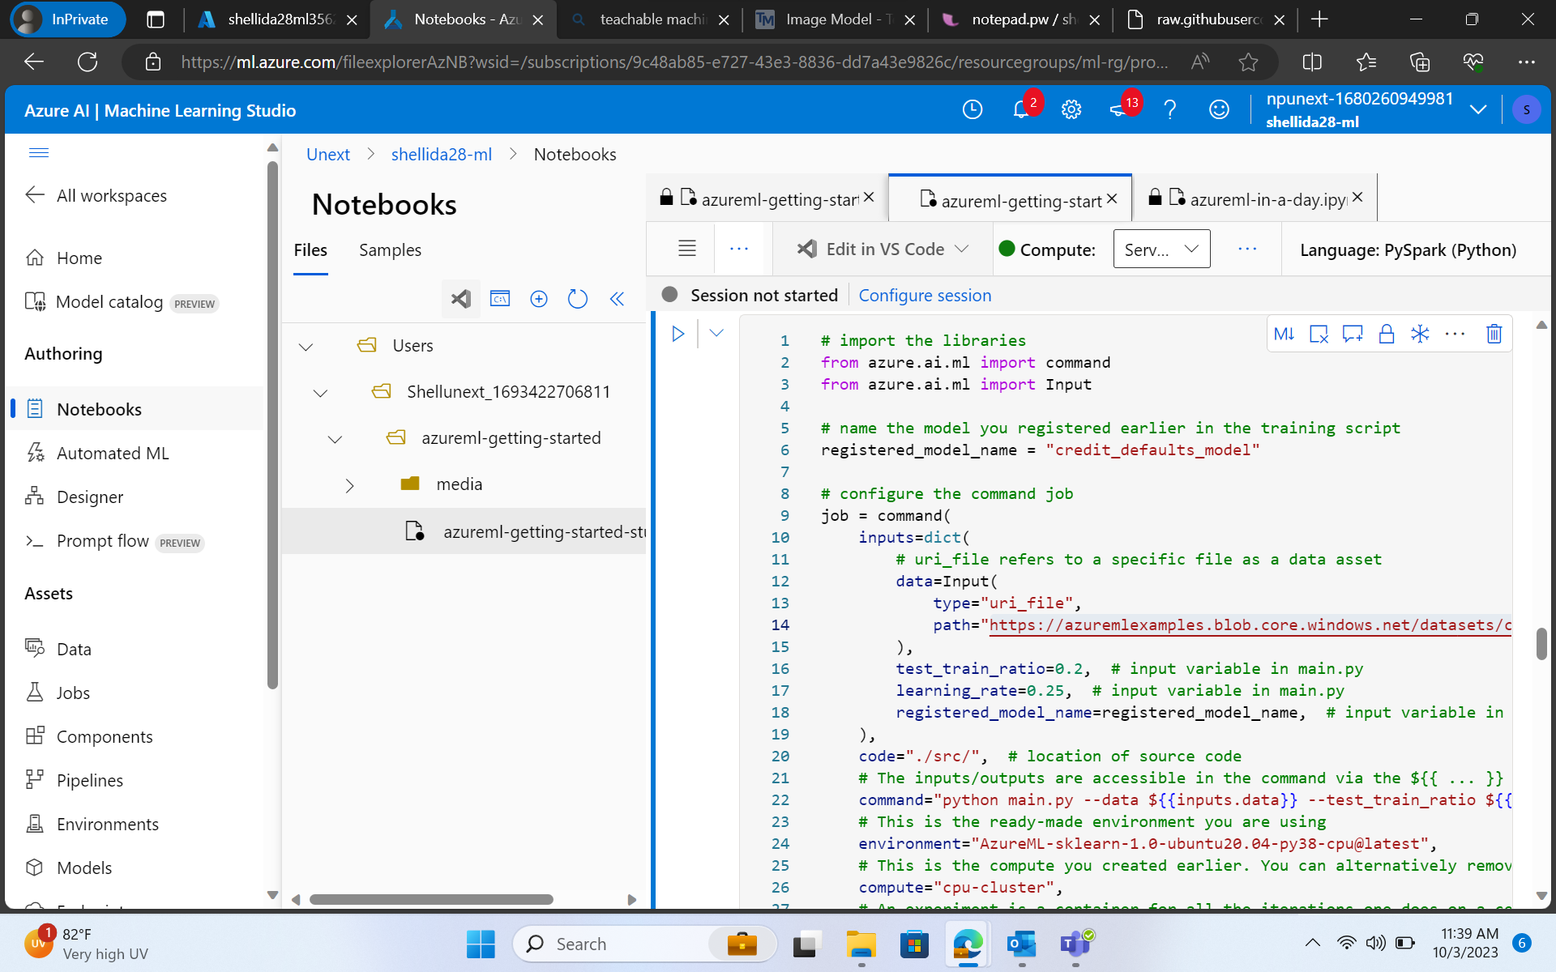
Azure ML

Slide 4
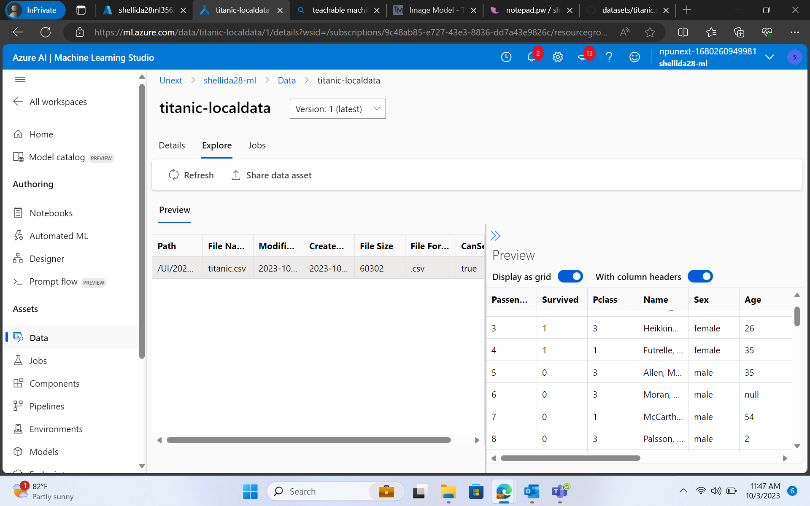
Azure ML

Slide 5
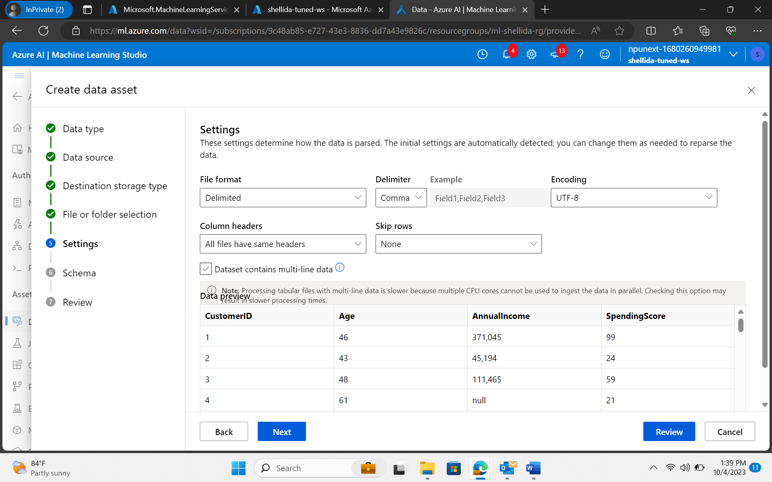
Day – 2 Azure ML

Slide 6
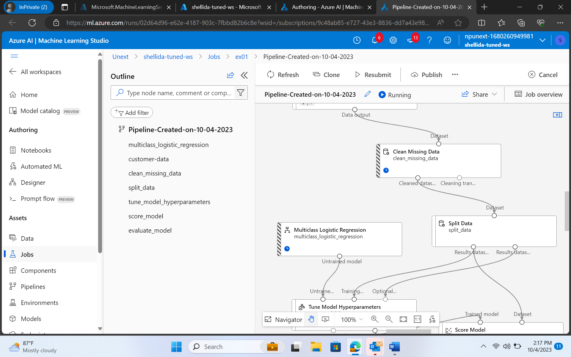
Azure ML

Slide 7
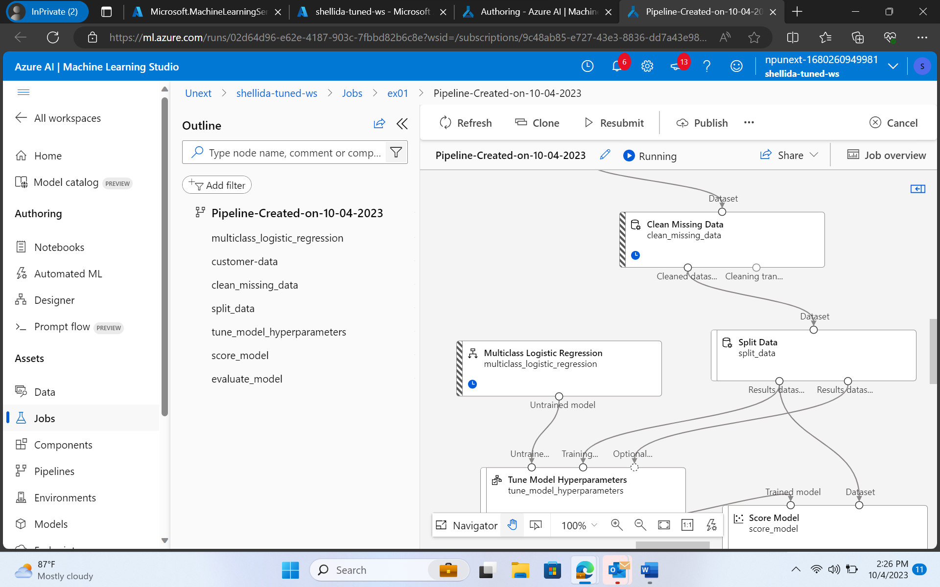
Azure Devops

